Slide 1
FACE , GENDER AND AGE DETECTION
ATHUL VAISHNAV C
MUHAMMED NAMEER P
SPENCER DAVID
SURENDRA PRATAP SINGH

Slide 2
INTRODUCTION
Age and gender, two of the key facial attributes, play a very foundational role in social interactions
Making age and gender estimation from a single face image an important task in intelligent applications
Applications in access control, human-computer interaction, law enforcement, marketing intelligence and visual surveillance etc…

Slide 3
OBJECTIVE
Our objective is to train a deep learning model using CNN to detect gender and age of input.
We want to try this model in a video file to detect faces and ages of persons in it.

Slide 4
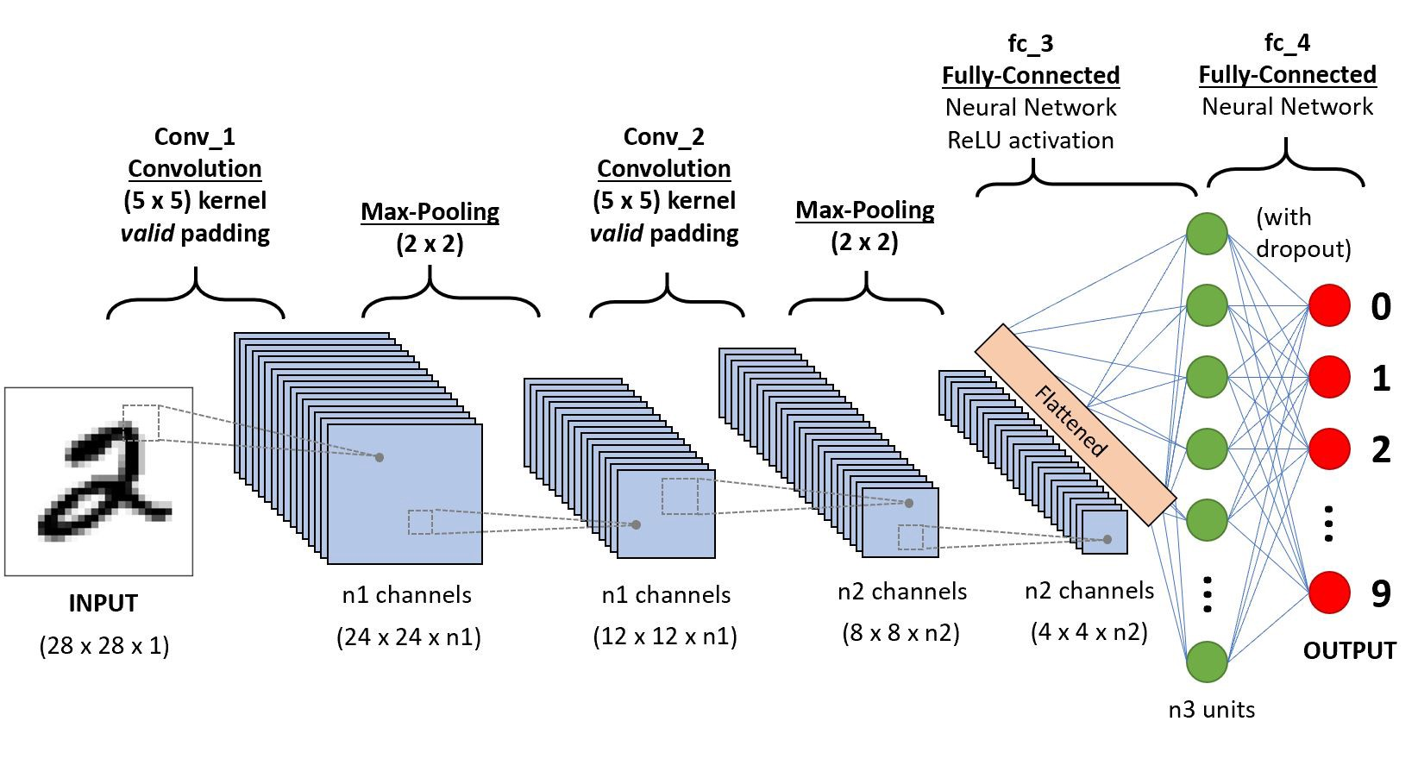
CONVOLUTIONAL NEURAL NETWORK

Slide 5
INFORMATION ABOUT DATASET AND MODEL
We used a pre-trained CNN model .
This model is trained on 20000 images which are classified in gender and age.
This model also contains weights and biases also.

Slide 6
METHODOLOGY
Input Images
Do necessary Data pre processing
Convert all the images into n-d array
Predict the test image
Load CNN model
Feed the Images to the network and fit the model
Now to test this model on video files we have to convert video file into frames
Feed those continues frames to CNN network.

Slide 7
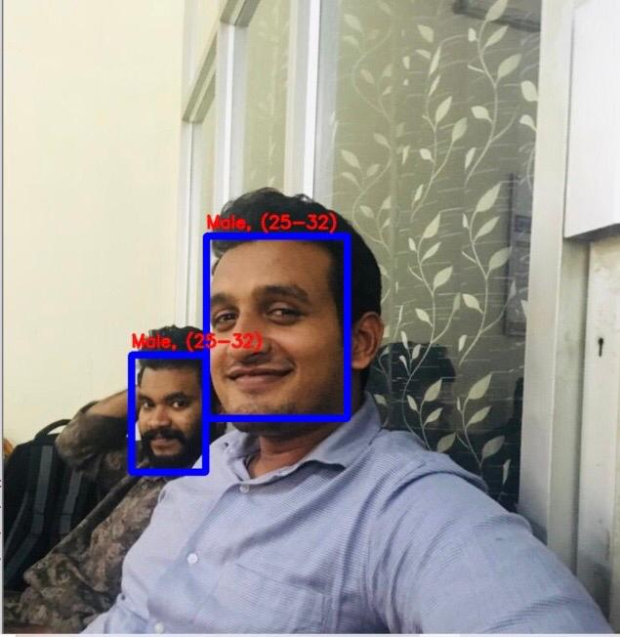
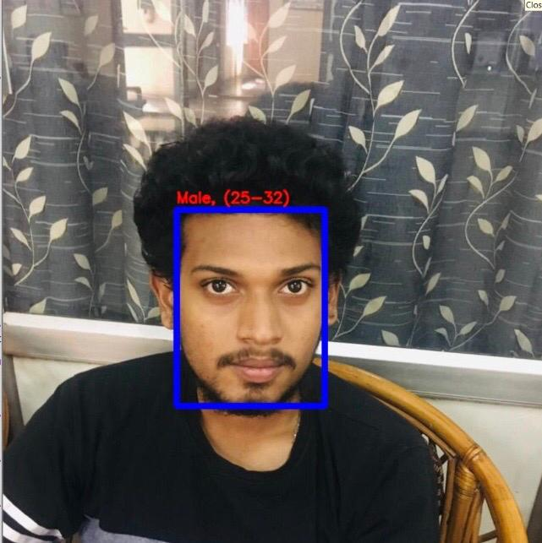
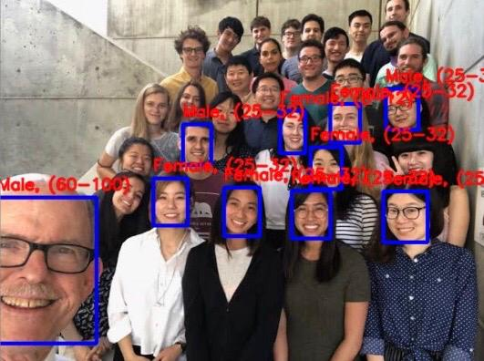
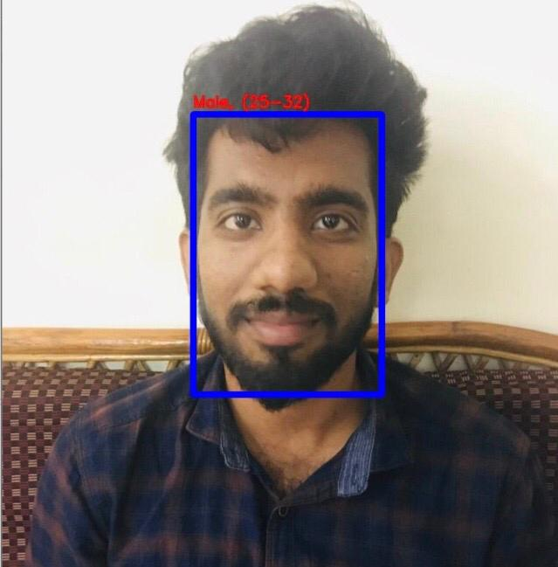
RESULT

Slide 8
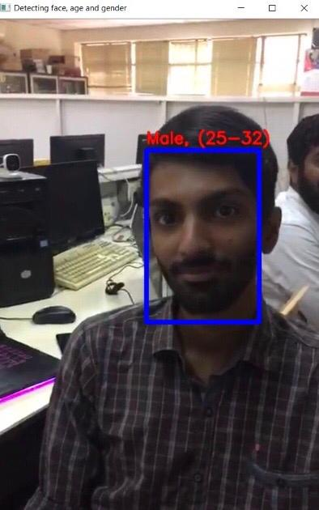
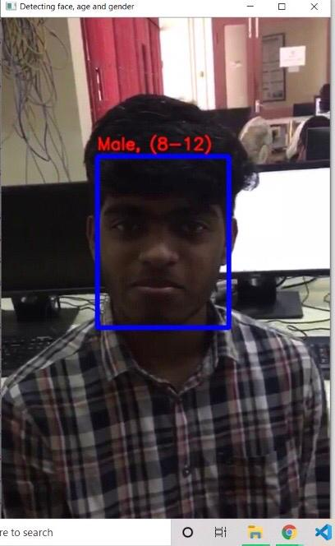
VIDEO RESULTS

Slide 9
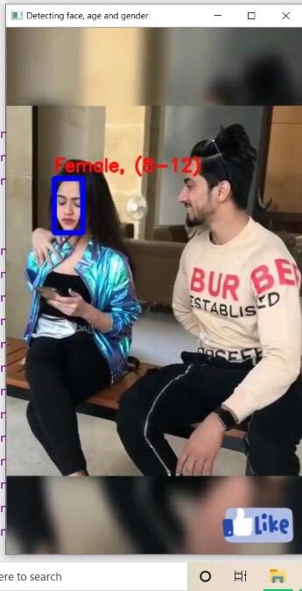
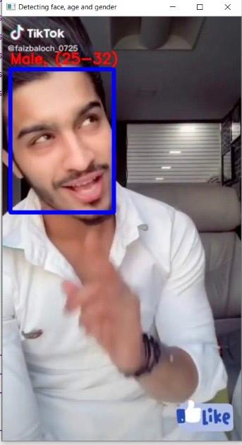

Slide 10
REFERENCES
https://talhassner.github.io/home/projects/Adience/Adience-data.html

Slide 11
THANK YOU

